Slide 1
Children as victims and witnesses in judicial and non-judicial processes
An Michels
Clinical Psychologist, Head Psychosocial Support Unit
Victims and Witnesses Section - ICC

Slide 2
Overview
Challenges regarding the participation of children in judicial and non-judicial processes
The psychosocial impact of armed conflict on children
The importance of post traumatic stress for the testimony process
Judicial vs Non-Judicial Mechanisms – advantages and challenges
Protection and support of child witnesses and victims
A child-centered and trauma-informed approach
Assessing the best interest of the child - a rights-based and a psychosocial perspective
Balancing children’s right to protection with their right to participate in a justice process
Special Measures in judicial procedures
How to implement a support mandate and use special measures : the example of the ICC
Questions and discussion

Slide 3
I. Challenges regarding the participation of children in judicial and non-judicial processes

Slide 4
Psychosocial impact of armed conflict on children
Impact of exposure to violence
Experiencing traumatic events
Sexual violence
Use of child soldiers – abduction
Impact of disruption of children’s lives
Displacement
Disruption of schooling – attacks on schools
Lack of access to health care
Impact on physical development
Impact of war on social fabric and support system

Slide 5
Experiencing traumatic events
A ‘traumatic event’ is an occurrence in which both of the following were present:
(a) the person experienced, witnessed or was confronted with an event or events that involved actual or threatened death or serious injury, or a threat to the physical integrity of others;
(b) the person’s reaction involved intense fear, helplessness, or horror. (DSM V)
“horror and/or helplessness”
Traumatic event is perceived as unexpected and unexplainable (“this is not possible, this is not happening to me”)
The victim or witness feels out of control

Slide 6
Symptoms of Post Traumatic Stress
3 Clusters:
Intrusion: recurrent flash-backs, intrusive thoughts, nightmares, feeling ‘as if it is happening again’ – reliving the event, triggers, repetitive play or re-enactment
Persistent avoidance: avoidance of places and people associated with the events,
Heightened arousal: difficulties sleeping or eating, irritability, poor concentration, anxiety, hyper vigilance/hyper arousal, increased startle reflex, constant alertness, recklessness and risk-taking behaviour, defiance, aggression, psychosomatic complaints (Stomach pains and headaches)

Slide 7
Symptoms of Traumatic Stress: Dissociation
Numbing, de-realization, de-personalization, amnesia, absence of emotional responsiveness
Often persistent defense mechanism which initially helped to survive the trauma
Dissociation is only option available to children (no chance to fight or flight)
Dissociative episodes appear as: day-dreaming, staring off, ‘freezing’, regression, sometimes micro-psychotic episodes with auditory hallucinations (hearing voice commanding them to harm themselves of others), sometimes changed body posture
Becomes non-adaptive:
appears at inappropriate times, when memories (through network) are triggered – following minor stresses
If confronted, children may quickly feel threatened and react with aggression over minor events.

Slide 8
Impact of traumatic stress on brain development
Impact on brain development: trauma leaves an imprint on the brain, mind and body (B. Van der Kolk)
May affect cognitive development – trauma affects maturation of central nervous system + lack of education = concentration and memory problems, reading problems, school drop-out
Indication of lower IQ in traumatised children – 25% of children underachieve after a disaster
May cause impairment in explicit and implicit memory (increase of cortisol levels – facilitation of activation of amygdala)
Hypersensitivity

Slide 9
IMPACT OF SEXUAL Violence
Physical injuries and chronic health conditions - pregnancy
Psychological impact
Feelings of shame and guilt - withdrawal
Anxiety
Suicidal thoughts
Sleeping problems
Psychosomatic complaints
Self-blame - identification with the aggressor
…

Slide 10
IMPACT OF sexual violence
Social impact
Social stigma
Social exclusion/withdrawal
Destruction of relationships
Exclusion from the community
Inability to marry and/or attachment to aggressor in case of sexual slavery
Children born of rape
Loss of income
Impact on family and community
Widespread sexual violence – targeting communities
Destruction of social fabric
Dislocation of families (e.g. violence committed in front of family members)
Transgression of taboos

Slide 11
IMPACT of child soldiering
https://www.youtube.com/watch?v=-ip08pjKngI

Slide 12
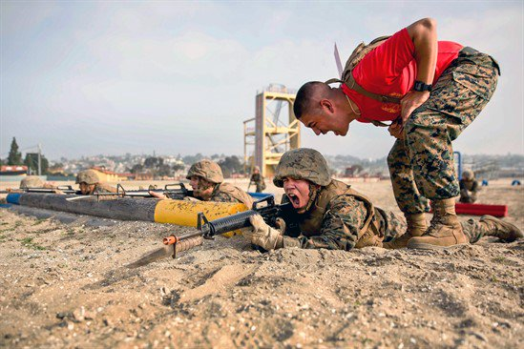
Impact of child soldiering
High exposure to traumatic stress -
Uganda (Schauer, 2007;)
100% experienced severe suffering (food deprivation, carrying heavy goods)
93% were threatened to be killed
90% experienced physical assault
78% saw dead bodies
45% experienced sexual violence
36% were forced to kill
38% were forced to mutilate or injure someone
8% were forced to skin, chop, or cook dead bodies
8% were forced to eat human flesh
In average 9 different Traumatic Events (Wessels, 2018)

Slide 13
Impact of child soldiering on emotional, cognitive and moral developments
Specific impact on child development:
Physical development – injuries, malnutrition, chronic stress
Emotional development: reduced affect regulation - Anti-social and aggressive behaviour:
Difficulties to control aggressive impulses
Numbing: normalisation of violence and suppression of normal emotional reactions increase aggression
Lack of skills to handle conflicts without violence/lack of social skills
Cognitive development – schooling

Slide 14
Moral and identity development
Identity development –
Trauma affects personality development
Collective identity: strong identification with own group; Development of pro-war attitudes, more often simplistic black and white worldview
Moral development – achieved through social interaction
Dual status of victim and perpetrator creates ambiguity
Moral dilemma: civilian values vs values of armed group
Compartmentalisation: “I have to put my values aside to survive” – protective factor
Coping strategies after release determines further moral development
Avoiding to think about what happened – psychological strategy
Avoiding to talk about what happened – social strategy
Inability to cope – inability to leave behind life in armed group – often because of high PTSD

Slide 15
Moral development – clinical observations in justice context
Strong sense of justice
Strong wish to repair the harm
Strong push to learn, study
Resilience – but also increased vulnerability – coping with later life-events

Slide 16
The importance of post traumatic stress for the testimony process
Why is trauma such a critical concept for testimony? Impact on information processing
Disturbances in physiological and cognitive processes during traumatic event may:
lead to difficulties to process information about the event
Impact on registration, storage and retrieval of information
Lead to persistent increased arousal
and/or withdrawal from situation
Dissociation during TE may lead to fragmented recall

Slide 17
Impact on information processing
‘Normal event’
Registration via sensory perceptions (see – hear – smell – feel)
Storage of declarative/explicit memories
‘Conceptually-driven processing’: information is linked to existing memories/known concepts and assimilated into existing schemata (and existing schemata are been modified)
Giving ‘sense’ to sensory information – creation of a narrative
Retrieval of (processed) narrative, not of purely sensory information

Slide 18
‘Traumatic event’
Registration via sensory perceptions (see – hear – smell – feel)
‘data-driven processing’: storage of ‘visual characteristics’ of information – exact reproduction of sensory information (as if it is a movie)
Because of cognitive factors: information is ‘unexplainable’ – does not fit into existing schemata
Because of physiological factors (hormonal response)
Storage of declarative memory fails
High level of data-driven processing = high level of trauma
Leads to creation of ‘traumatic memory’
Retrieval of information about traumatic event brings back (unprocessed) sensory information – and triggers intense emotions (as if it is happening again)
Memory is ‘scattered’, fragmented, not chronological (images, sounds, smells)

Slide 19
Consequences for the testimony process:
Risk of resurfacing of trauma during interview/testimony process
Being asked to recount the TE can trigger strong emotional/traumatic reactions (intense anxiety, nightmares/flash-backs, suicidal thoughts, dissociation…)
Risk of low credibility
Impossibility to give coherent statement (lack of chronology, memory gaps)
Creation of ‘false narrative’: Filling in the blanks by inappropriate questioning (leading questions)

Slide 20
Challenges and benefits
James was 16 at the time he gave his first statement to the OTP. He was a former child soldier, a bright young man who was successful in school and who tried to leave his past behind him. He was included in the ICCPP at age 17 and was initially resettled internally, prior to testimony. He had lost contact with his family but restored contact with his father at the time of resettlement. James had a lot of security concerns when he testified. He was particularly concerned about the reactions within his community of origin, as he felt a traitor because of his decision to testify. He struggled with that as he also really wanted to restore what he, in his eyes, destroyed as a child soldier. The time of testimony was very stressful to him, he was also anxious to miss school, and reacted by becoming very demanding. At one point his testimony was even postponed as he refused to take the stand before certain conditions where met. Eventually he did testify, but because of a number of reasons it was decided that he could not return home and he entered the ICCPP.

Slide 21
Involvement of children in Judicial vs non-judicial mechanisms
What are in your view the challenges and benefits?

Slide 22
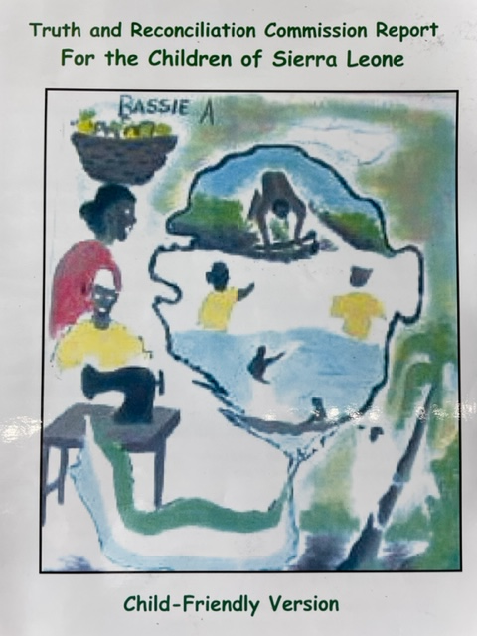

Slide 23
judicial vs non-judicial mechanisms – BENEFITS
International judicial mechanism
Non-judicial mechanism (truth commission)
Limited number of child witnesses
Well-resourced support and protection
Positive experience for witnesses
High impact
Restorative character
Can involve more children
Easier to adapt procedures to needs of children
Absence of punitive elements and adversarial system lessens burden on children
Room for innovation: outreach, children’s hearings/report

Slide 24
judicial vs Non-judicial mechanisms - Challenges
International Judicial Mechanism
Non-judicial mechanism
Child testimony has less direct impact
Often less resources available to set up support and protection
Impact of mechanism can be more indirect and/or outcome non-binding(recommendations)
Child as provider of evidence
Strict rules of procedure and evidence
adversarial system
Limitations can be experienced as a burden
Direct confrontation with the accused
Retributive goal
Slow proceedings

Slide 25
II. Protection and support of child witnesses and victims

Slide 26
A child-centered and trauma-informed approach
What is it and why is it important?

Slide 27
Assessing the best interest of the child - a rights-based and a psychosocial perspective
Right-based perspective:
Guiding principle of CRC – Children’s right to have their best interests taken into consideration in decision making regarding their wellbeing
Closely related to “Evolving Capacities”
Legal definition of a child (18)
Legal obligation in most domestic legal systems

Slide 28
Assessing the best interest of the child
Psychosocial perspective:
Assessment to determine vulnerability, protective factors and evolving capacities
Evolving capacities can include, but are not limited to:
Ability to understand and communicate relevant information;
ability to think and choose with some degree of independence;
ability to assess the potential for benefit, risk and harm;
achievement of a fairly stable set of values
No clear age cut-off

Slide 29
Vulnerability is a lens, not a label:
Definition of Vulnerability:
Vulnerable witnesses and victims face an increased risk:
To suffer psychological harm through the process of testifying and/or
To experience psychosocial or physical difficulties during testimony, which affect their ability to testify
Criteria for vulnerability:
Nature of the crime: in particular crimes of sexual/gender-based violence and crimes against children
Person: Age, disability, history of mental health/psychosocial problems
Particular circumstances: stress or anxiety related to protection, relocation

Slide 30
Balancing children’s right to protection with their right to participate in a justice process
What do we mean by this and why is it important?

Slide 31
How to implement a support mandate and use special measures : the example of the ICC
Art 68 – The Court shall take appropriate measures to protect the safety, physical and psychological well-being, dignity and privacy of victims and witnesses. In doing so, the Court shall have regard to all relevant factors, including age, gender (…) and health, and the nature of the crime , in particular, but not limited to, where the crime involves sexual or gender violence or violence against children. The prosecutor shall take such measures particularly during investigation and prosecution of such crimes. These measures shall not be prejudicial to or inconsistent with the rights of the accused and a fair and impartial trial.

Slide 32
ICC Victims and Witnesses Section – support mandate
ART43.6: Unit shall provide in consultation with the Office of the Prosecutor, protective measures and security arrangements, counselling and other appropriate assistance for witnesses, victims who appear before the Court, and others who are at risk on account of testimony given by such witnesses. The Unit shall include staff with expertise in trauma, including trauma related to crimes of sexual violence.

Slide 33
ICC Psychosocial Support: facilitation of testimony and prevention of further harm
Psychological assessment and support to witnesses and victims:
Witness Protection (ICCPP)
Trial support: before, during and after testimony
Direct and indirect interventions
Assessment, support, familiarisation, referral
Expert advice to section, Registry, Court
Interventions to improve quality of services – do no harm
Strong focus on vulnerability

Slide 34
USE of RUlE 88 special measures
Recommendations for Special Measures
In-court assistance/monitoring by psychologist
Change set up of the Courtroom
Shielding the witness from the accused
Adjustment of questioning
Avoid unnecessarily intrusive and/or embarrassing questions
Avoid repetitive questions
Use developmentally appropriate questions
Use simple language, avoid legal terminology
Offer frequent breaks, change sitting hours
Video-link or remote room

Slide 35
Trial Support: observations
Very important social and cultural component
Very diverse clinical expressions of trauma and other symptoms of mental suffering, differences in hierarchy of problems
E.g. Significance of nightmares, somatisation, etc.
Importance of shame, fear for social exclusion and rejection
Need to understand cultural concepts of distress – syndromes, idioms, explanations or perceived causes
Differences in introspection - lack of words to describe individual psychological suffering

Slide 36
Trial Support: observations
Link between:
expectations around testimony/motivation – introspection/awareness about symptoms and
quality of testimony and psychological impact of testimony
“Hidden vulnerabilities”

Slide 37
Testimony paradoxes
Trials in international criminal tribunals rely heavily on witness testimony, while witnesses, because of their prior exposure to conflict, also often are the weakest link in the process
Very vulnerable witnesses can be very strong witnesses, if appropriate level of support is provided.
Trauma-related factors which contribute to a deterioration of mental health and social functioning are at times protective factors during testimony,
e.g.: symptoms and alterations of personality focused on self- preservation; learned helplessness
The meaning given to the experience of testifying can contribute to healing or to further alienation.

Slide 38
Witness protection paradox
What is good for protection is often bad for psychosocial well-being and bad for recovery from trauma

Slide 39
Protection principles
confidentiality, separation/isolation, cover story/legend, dependency on handler
Good practices regarding support of vulnerable persons coming from war-affected countries
In case of ICC: often witnesses from non-western cultures who express suffering in spiritual, religious, family or community terms

Slide 40
An.Michels@icc-cpi.int
@anmichels
Thank you!

